Slide 1
Bridge, Facade, Flyweight
Structural patterns

Slide 2
Bridge Pattern
Bridge is a structural design pattern that lets you split a large class or a set of closely related classes into two separate hierarchies—abstraction and implementation—which can be developed independently of each other.
This pattern involves an interface which acts as a bridge which makes the functionality of concrete classes independent from interface implementer classes.

Slide 3
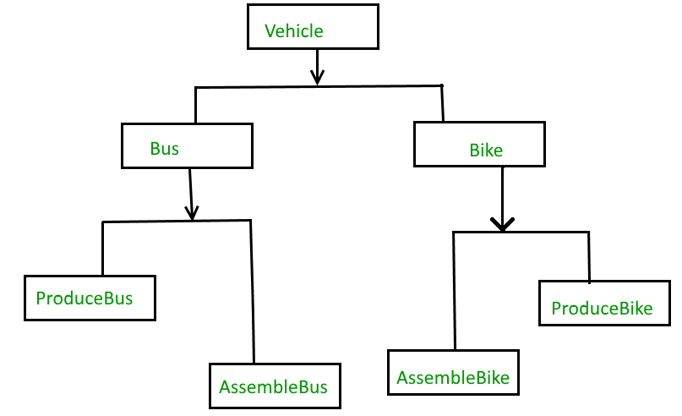
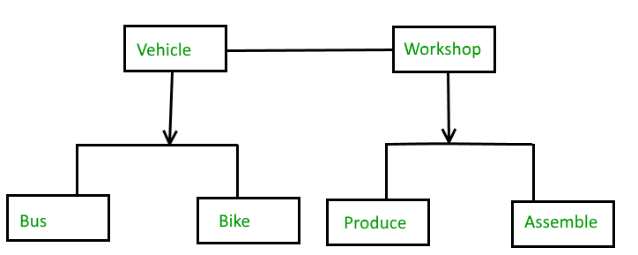
Bridge Pattern
With out Bridge Pattern
With Bridge Pattern

Slide 4
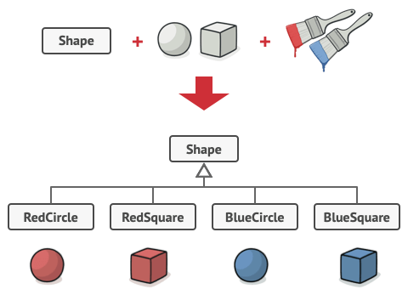
Bridge Pattern

Slide 5
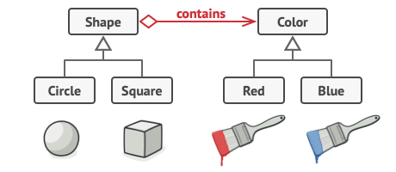
Bridge Pattern

Slide 6
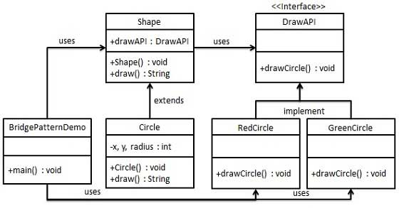
UML Diagram of Bridge Pattern

Slide 7
HW
Implement Bridge Pattern
Correlation between Decorator and Bridge

Slide 8
Facade Pattern
Facade pattern hides the complexities of the system and provides an interface to the client using which the client can access the system.
This type of design pattern comes under structural pattern as this pattern adds an interface to existing system to hide its complexities
This pattern involves a single class which provides simplified methods required by client and delegates calls to methods of existing system classes

Slide 9
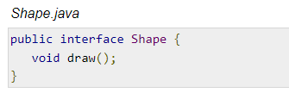
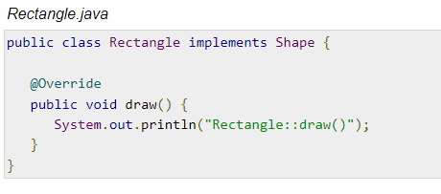
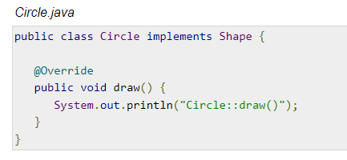
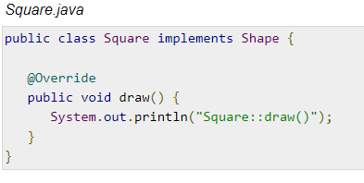
Facade Pattern

Slide 10
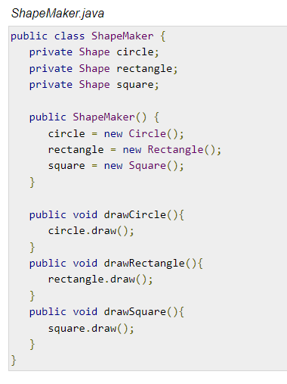
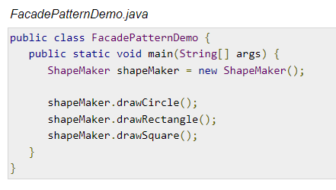
Facade Pattern

Slide 11
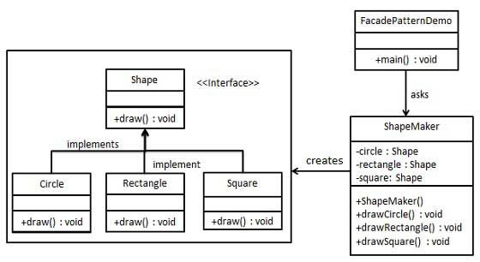
UML Diagram of Façade Pattern

Slide 12
Façade Pattern
Similar pattern od façade is abstract factory.
Why abstract factory is creational and facade is structural?

Slide 13
Flyweight Pattern
Flyweight pattern is primarily used to reduce the number of objects created and to decrease memory footprint and increase performance.
This type of design pattern comes under structural pattern as this pattern provides ways to decrease object count thus improving the object structure of application
Flyweight pattern tries to reuse already existing similar kind objects by storing them and creates new object when no matching object is found.

Slide 14
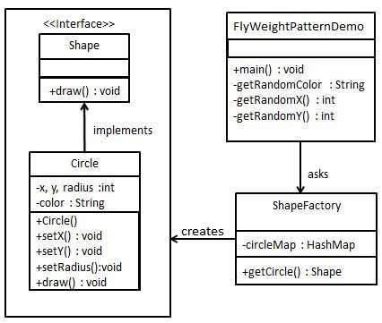
UML Diagram of Flyweight Pattern

Slide 15
Flyweight Pattern
Using 5 colors, can you create 20 objects of circles only creating 5 objects?

